Slide 1

Lifestyle Store
A Pentesting detailed report

Slide 2
SECURITY STATUS -EXTREMELY VULNERABLE
Hacker can steal all records in Lifestyle Store databases (SQLi)
Hacker can take control of complete server including View, Add, Edit, Delete files and folders
(Shell Upload and Weak Passwords)
Hacker can change source code of application to host malware, phishing pages or even explicit
content (Shell Upload)
Hacker can get account details of another customer like by changing the number in edit
profile link(IDOR)
Hacker can get access to seller details and login into the website using customer of the month
usernames(PII)
Hacker can send multiple requests (Rate Limiting Flaw).
Hacker can add /remove items in the cart (CSRF)
Use off http instead of https.
Cookie Flaws.

Slide 3
Vulnerability Statistics
15
Severe
Critical
26
10
Moderate
4
Low

Slide 4
Vulnerabilities
No. | Severity | Vulnerability | Count
1 | Critical | SQL Injection | 1
2 | Critical | Arbitary File Upload & Local File inclusion | 3
3 | Critical | Access to admin panel | 1
4 | Critical | Access via OTP bypass | 2
5 | Critical | Unauthorized access to customer details | 5
6 | Critical | Command execution | 2
7 | Critical | Force browsing | 1
8 | Severe | Cross site scripting | 4
9 | Severe | Crypto Configuration flaw | 1
10 | Severe | Common Passwords | 2
11 | Severe | Rate Limiting Flaw | 4
12 | Severe | Open Redirection | 3
13 | Severe | Cross site request forgery | 3

Slide 5
No. | Severity | Vulnerability | Count
14 | Severe | Unauthorized availability of details | 9
15 | Moderate | Information disclosure due to default pages | 5
16 | Moderate | Unnecessary details about the sellers | 3
17 | Moderate | Components with well known vulnerabilities | 2
18 | Low | Default error display | 2
19 | Low | Improper server side & Client side filters | 2
All | Conclusion | Total no.of vulnerabilities found | 55

Slide 6
1.SQL injection
1. SQL injection(Critical)
Below mention URL is vulnerable to SQL injection. Affected URL : ---> http://3.108.193.22/products.php?cat=3 Affected Parameters : ---> cat (GET Parameter) Payload : cat=3’

Slide 7
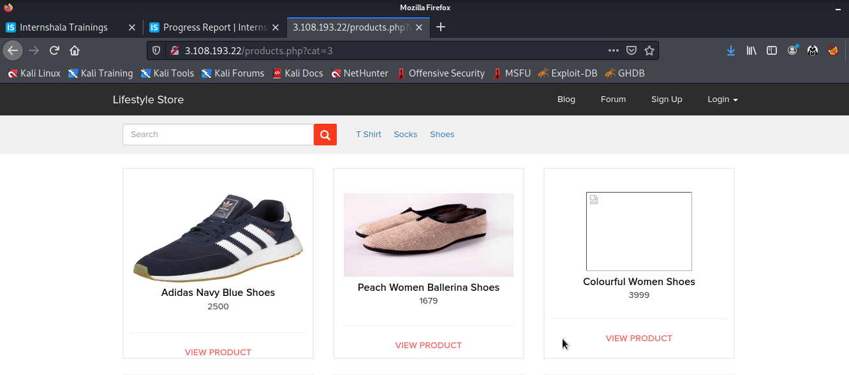
Observation
As we can observe in website go to shop now, navigate to Shoes tab.Notice the GET parameter cat=3 in the URL:

Slide 8
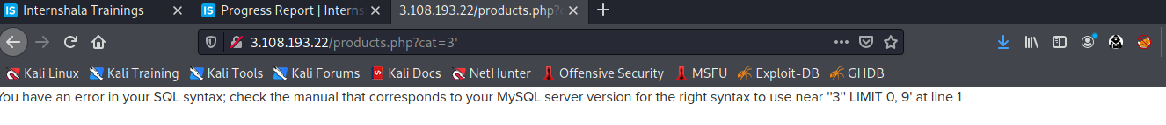

Observation
we apply single quote in house parameter: products.hp?cat=3’ and we get SQL error
we then put --+:products.php?cat=3’ --+ and error is removed confirming sql injection

Slide 9
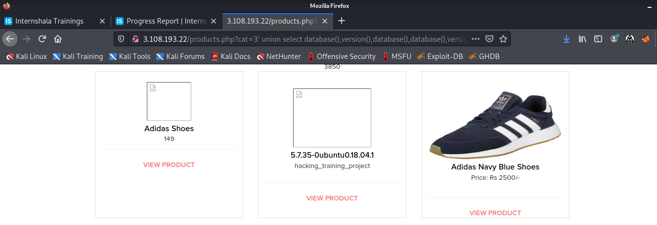
Proof of concept(PoC)
Attacker can execute SQL commands as shown below. Here we have used the payload below to extract the database name and MySQL version information:
http://3.193.108.22/products.php?cat=1' union select database(),version(),database(),database(),version(),version(),version() --+

Slide 10
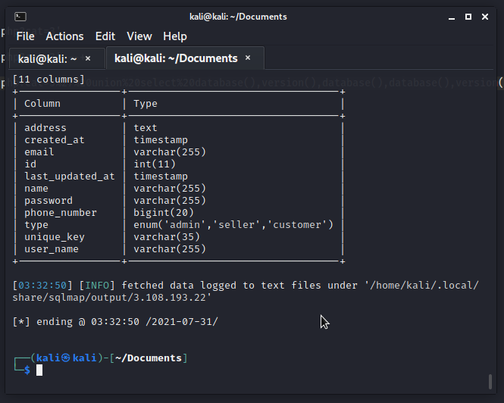
No of databases: 2
information_schema
hacking_training_project
No of tables in SQL_Injection_V3: 10
brands
cart_items
categories
customers
order_items
orders
product_reviews
products
sellers
users

Slide 11
Business Impact - Extremely High
Using this vulnerability, attacker can execute arbitrary SQL commands on Lifestyle store server and gain complete access to internal databases along with all customer data inside it.
Below is the screenshot of some information extracted from users table which shows user credentials being leaked .Since the passwords are hashed ,the risk is comparatively low .
Attacker can use this information to attack the users and login to admin panels and gain complete admin level access to the website which could lead to complete compromise of the server and all other servers connected to it.

Slide 12
Recommendation
Take the following precautions to avoid exploitation of SQL injections:
Whitelist User Input: Whitelist all user input for expected data only. For example if you are expecting a flower name, limit it to alphabets only upto 20 characters in length. If you are expecting some ID, restrict it to numbers only
Prepared Statements: Use SQL prepared statements available in all web development languages and frameworks to avoid attacker being able to modify SQL query
Character encoding: If you are taking input that requires you to accept special characters, encode it. Example. Convert all ‘ to \’ , “ to \”, \ to \\. It is also suggested to follow a standard encoding for all special characters such has HTML encoding, URL encoding etc
Do not store passwords in plain text. Convert them to hashes using SHA1 SHA256 Blowfish etc
Do not run Database Service as admin/root user
Disable/remove default accounts, passwords and databases
Assign each Database user only the required permissions and not all permissions.

Slide 13
References
https://www.owasp.org/index.php/SQL_Injection https://en.wikipedia.org/wiki/SQL_injection

Slide 14
2.Insecure /Arbitrary File Uploads
This happens when applications do not implement proper file type checking and allow uploading of files of different file formats. For example, a PHP file instead of a jpeg profile picture.
2. Arbitary File Upload(Critical)
Below mention URL is vulnerable to Arbitary File Upload. Affected URL : http://3.193.108.22/wondercms Affected Parameters : Files(POST perameter) The attacker can upload files with extension other than .jpeg . Affected URL : http://13.193.108.22/profile/2/edit/ Affected parameters : Upload a profile(POST parameters) Affected URL: http://13.233.124.212/?includelang=(payload) Payload used (../../../../../../../etc/passwd

Slide 15
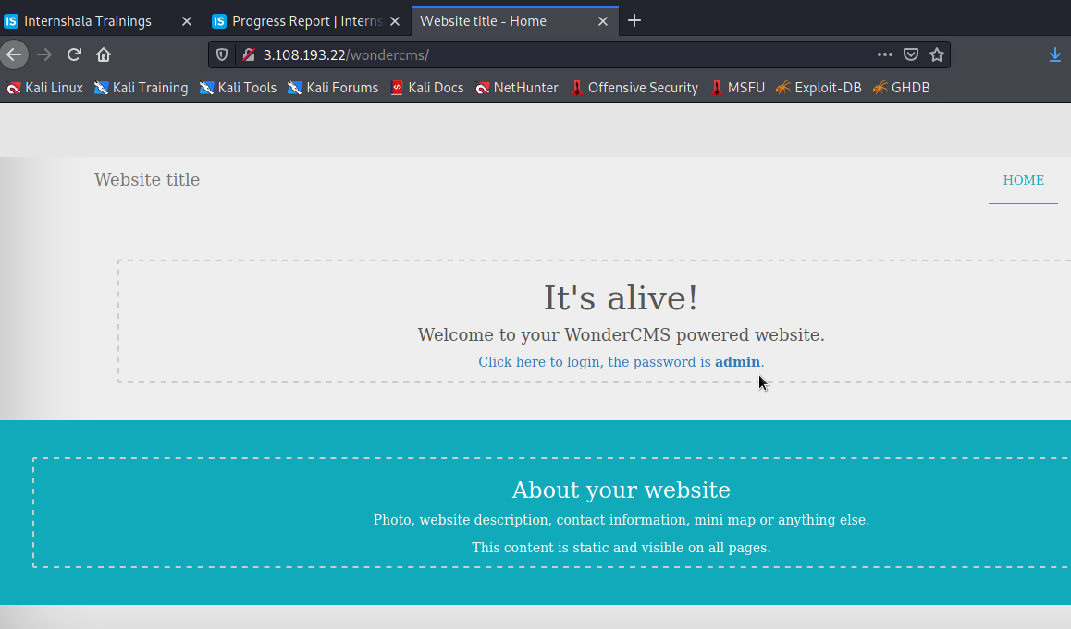
Observation
Login using any of the user’s details on the Lifestyle store and navigate to Blog tab . Now click on Login and put the password - admin.
You will see the following page and then click on Settings tab.

Slide 16
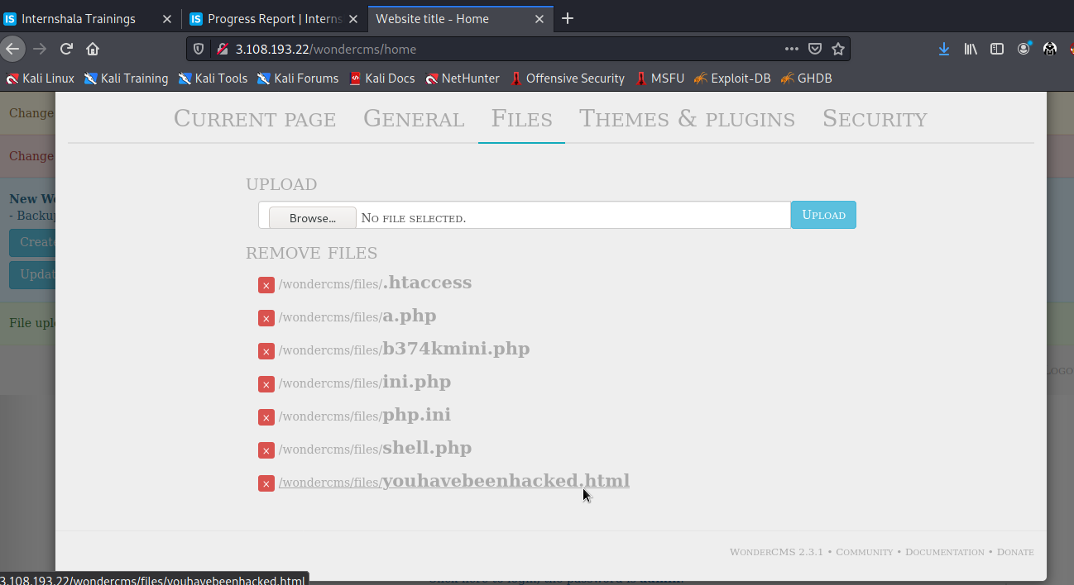
Observation
Click on Files tab . Here hacker can upload the file like shown .
Click on the uploaded file youhavebeenhacked.html and it will be opened

Slide 17
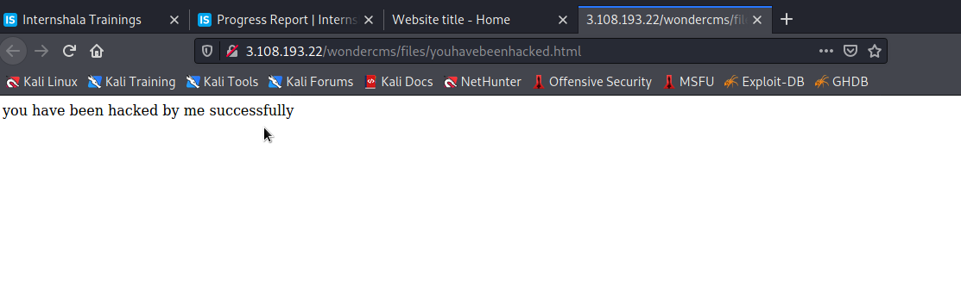
Proof of Concept (PoC)
Weak password - admin.
Arbitrary File Inclusion.
Below is the result of the uploded file in the previous slide likewise some malicious shell can be uploaded as well.

Slide 18
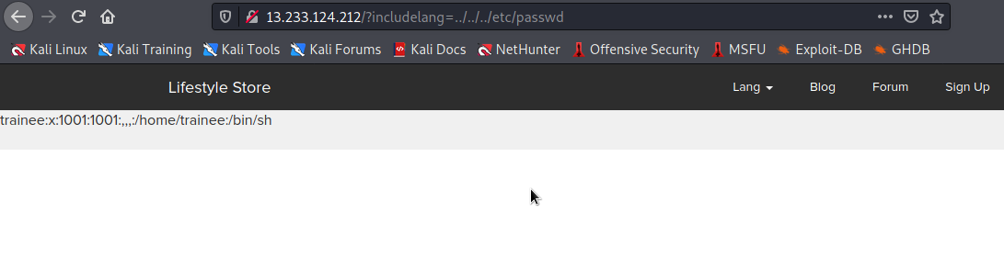
Proof of concept(PoC)

Slide 19
Business Impact – High
Using this type of vulnerability, attacker gain full control or access of server and back end system. Attacker inject the malicious file or malicious PHP code to gain control and attacker can easily done the client side attack.
Attacker can upload the malicious file or shell in site. With the shell upload ha/she can change the code or gain full access of all database which is there in that site.
Attacker maybe upload mini shell, malicious code, malicious virus in site server and execute that code by administrator in the victim’s system. So, impact of this vulnerability is very high.
An attacker might be able to put a phishing page into the website or deface the website and much more.
Recommendation
Blacklisting file extensions like .php, .html, etc.
Whitelist file extensions like .jpg, .pdf, etc.
Use static file hosting servers like CDNs and File Clouds to store files instead of storing them on the application server itself
Use proper server-side validation on what kind of file is uploading by user.
Rename the files using a code, so that the attacker cannot play around with file names.

Slide 20
Reference
https://owasp.org/www-community/vulnerabilities/Unrestricted_File_Upload
https://www.go4expert.com/articles/understanding-arbitrary-file-upload-t26351/
https://www.getastra.com/e/malware/infections/arbitrary-file-upload-vulnerability

Slide 21
3. Access to admin panel
3. Access to admin panel(Critical)
Below mention URL is vulnerable Affected URL : http://3.108.193.22/wondercms/loginURL

Slide 22
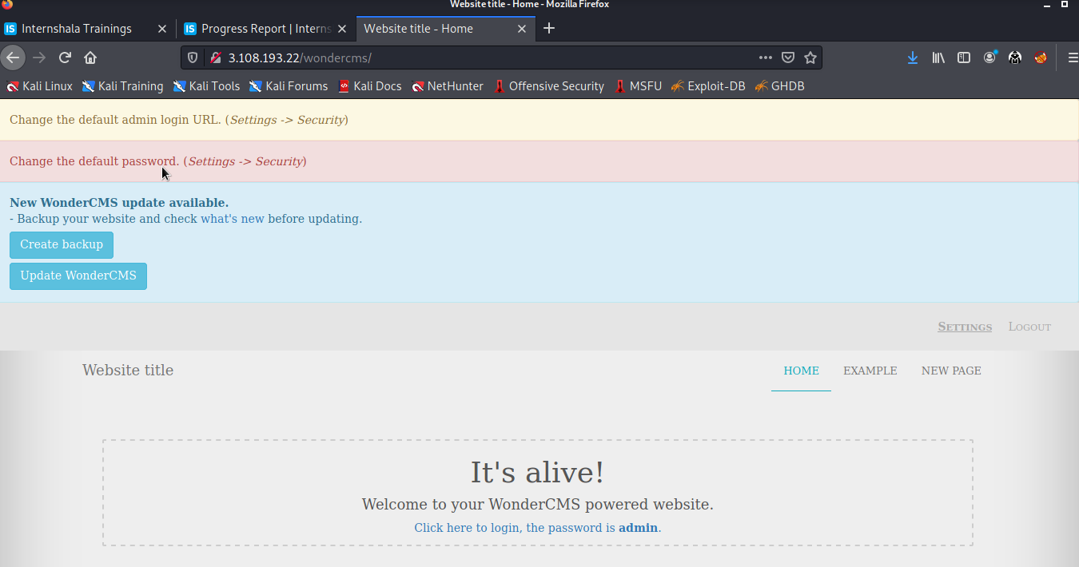
Observation
We are enter into the admin panel of blog with the entered password : admin and see the admin panel

Slide 23
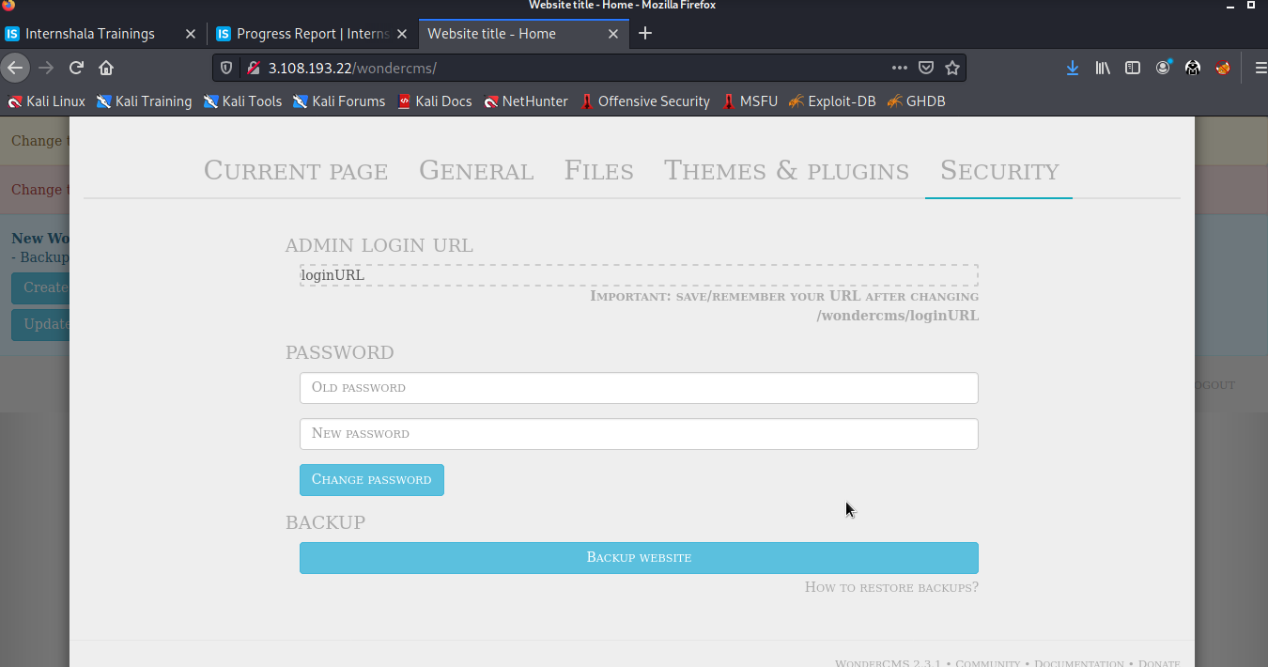
Proof of Concept(PoC)
In the admin panel we change the layout or content of the website and also change the password of the admin panel so next time the admin will not login in to the admin panel.

Slide 24
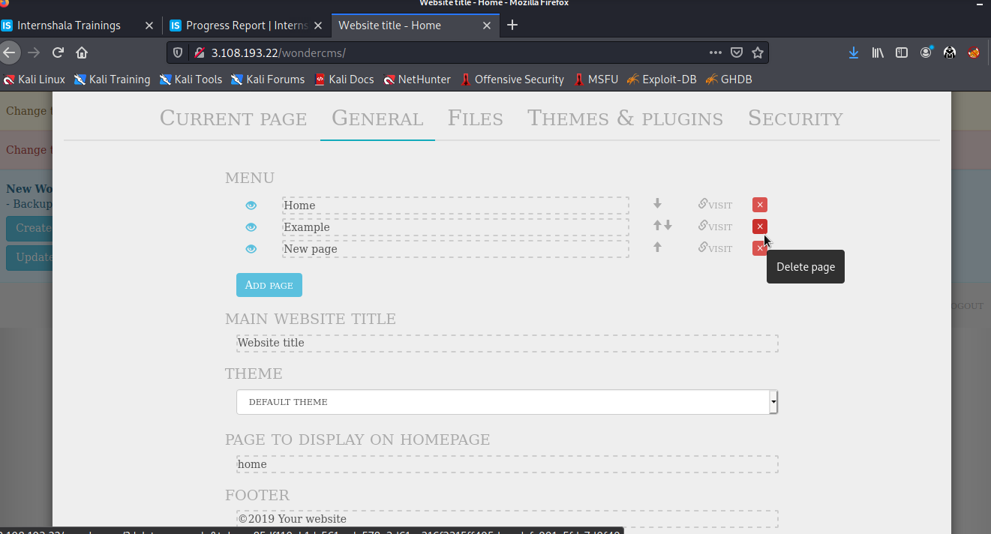

Slide 25
Business Impact – High
Using this vulnerability, attacker can login to the admin panel and change the layout of the website. Attacker can also change the content of the website by this admin panel.
Attacker can add some malicious code, some kind of videos, blogs that are not belong to this website this is impact on company’s raputation.
Attacker can add and delete the pages in this panel.
Attacker change the password of this admin panel so admin can not login in to this panel after attack.
Recommendation
The default password should be change into the strong password.
Password changing process must be done with some steps of verifications.
The admin url must also not accessible to normal user.
All default account should be removed.

Slide 26
Reference
https://owasp.org/www-community/vulnerabilities/Use_of_hard-coded_password
https://www.acunetix.com/blog/web-security-zone/common-password-vulnerabilities/

Slide 27
4.Access via OTP Bypass
 | The admin dashboard at the below mentioned URL has 3 digit otp allowing
 | brute forcing the otp and reset the password and gaining access.
 | Affected URL :
 | http://3.108.193.22/reset_password/admin.php
Access via OTP
Bypass(Critical) | Affected Parameters :
 | OTP (GET parameters)
 | Payload used :
 | otp=123

Slide 28
4.Access via OTP Bypass
 | The coupon code at the below mentioned URL can be bruteforced.
 | Affected URL :
 | http://3.108.193.22/cart/cart.php
Access via OTP | Affected Parameters :
Bypass(Critical) | apply_coupon(POST parameters)
 | Payload used :
 | UL-1056(bruteforced)

Slide 29
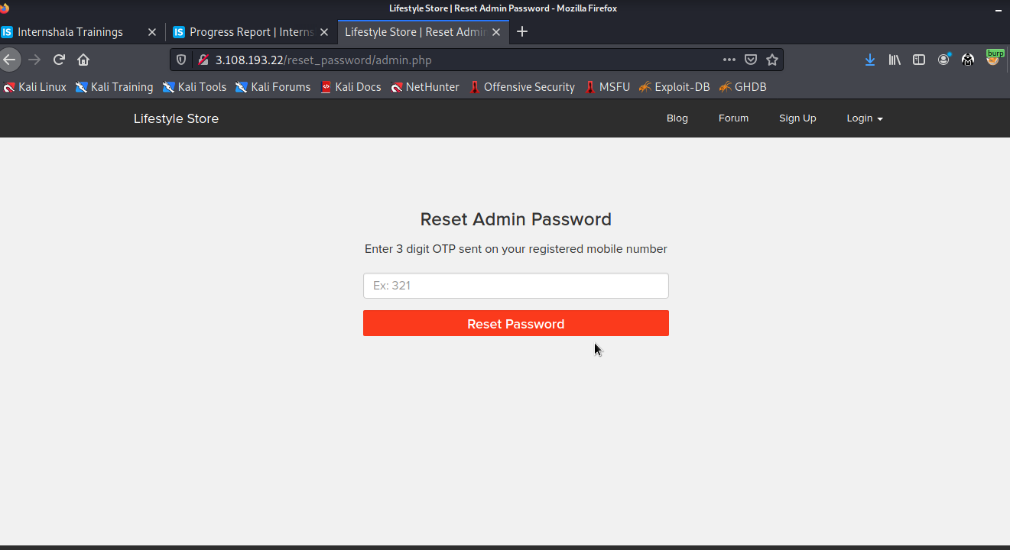
Observation
• Navigate to http://3.108.193.22/reset_password/admin.php You will see reset password page via OTP.
Enter random otp while capturing requests in a local proxy .

Slide 30
Observation
On brute forcing the 3 digit otp , under the length column the value which is distinct from others yields the correct otp - 123
Enter this otp in the captured request

Slide 31
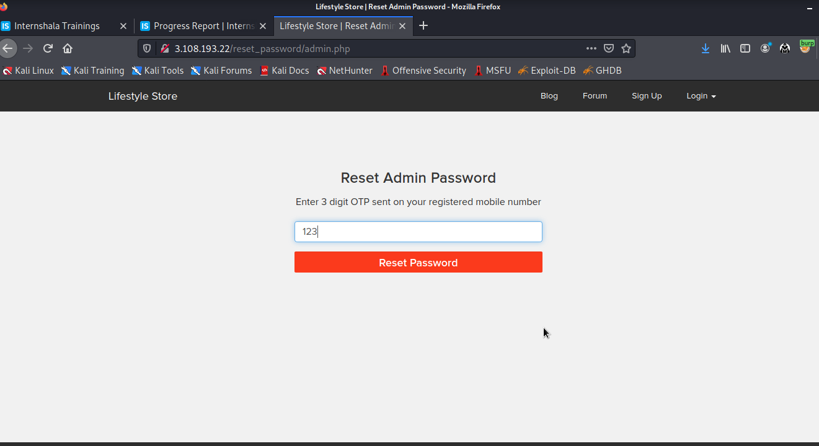
OTP

Slide 32
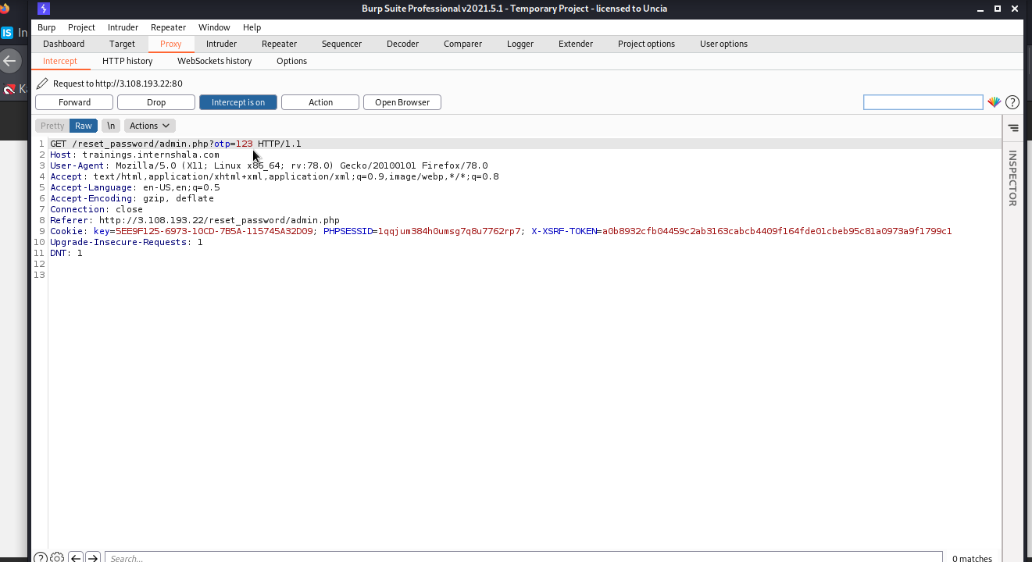

Slide 33
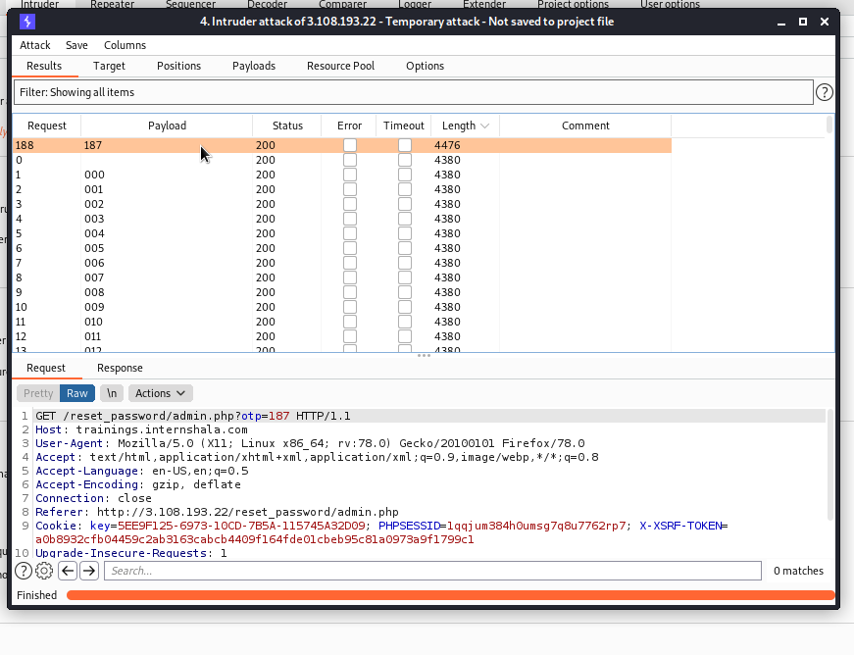
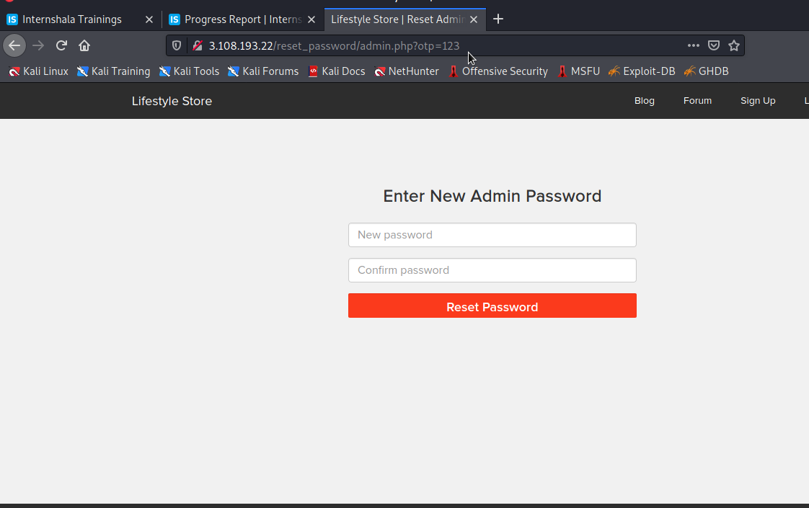
OTP bypassed
redirected to change password

Slide 34
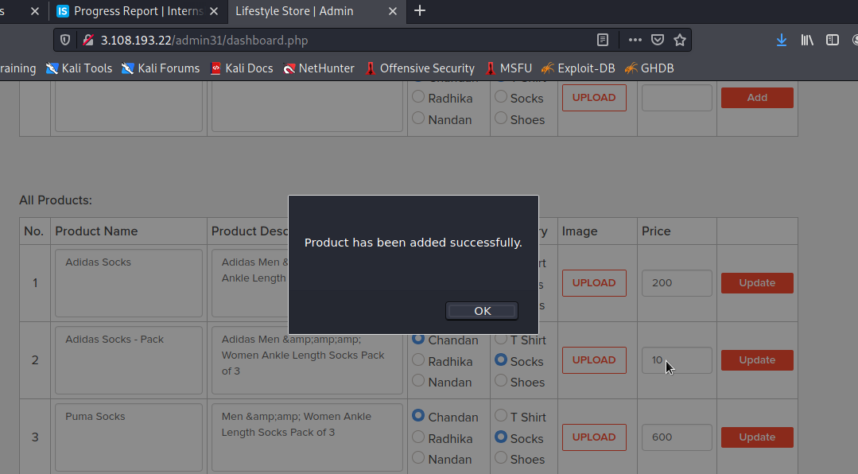
Observation
You will be redirected to the admin dashboard where you can see the details of all the users/sellers/customers.

Slide 35
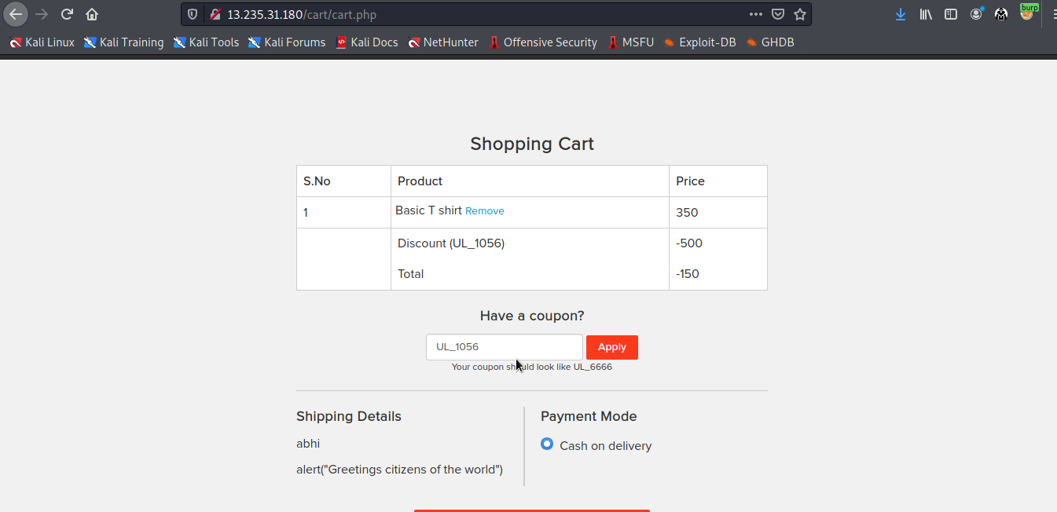
Proof of Concept (PoC)
At url http://3.108.193.22/cart/cart.php coupon code - UL-1056 is applied.
By bruteforcing we can find the coupon code

Slide 36
Business Impact –Extremely High
A malicious hacker can gain access to any account and change the information about the products. This may lead to defamation of the seller and the website which the customer trusts.
Attacker once logs in can then carry out actions on behalf of the admin which could lead to serious loss to any
user.

Slide 37
Recommandations
Take the following precautions:
• Use proper rate-limiting checks on the no of OTP checking and Generation requests
• Implement anti-bot measures such as ReCAPTCHA after multiple incorrect attempts
• OTP should expire after certain amount of time like 2 minutes
• OTP should be at least 6 digit and alphanumeric for more security.
References
https://www.owasp.org/index.php/Testing_Multiple_Factors_Authentication_(OWASP-AT-009)
https://www.owasp.org/index.php/Blocking_Brute_Force_Attacks

Slide 38
5.Unauthorised access to customer details
Unauthorised Access To Customer Details (Critical) | The below mentioned login page allows you to change password without verification and view details of other customers (CSRF). Affected URL : http://13.235.31.180/reset_password/customer.php Affected Parameters : Reset Password button (POST parameter) We can change the details of the user’s account details. Affected URL : http://13.235.31.180/profile/2/edit/ Affected Parameters : Update button (POST parameter)

Slide 39
5.Unauthorised access to customer details
Unauthorised Access To Customer Details (Critical) | Similarly after gaining access over the account , Hacker can remove/add/confirm items in the cart of the user (CSRF). Affected URL : http://13.235.31.180/cart/cart.php Affected Parameters : Remove option (POST parameter) Affected URL : http://13.235.31.180/cart/cart.php Affected Parameters : Confirm order option (POST parameter)

Slide 40
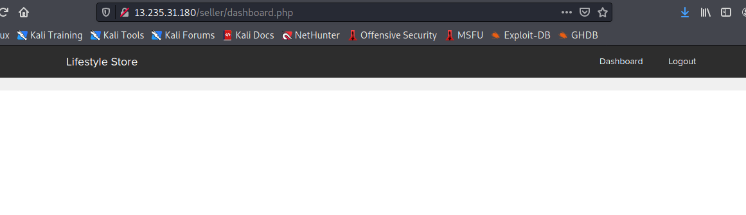
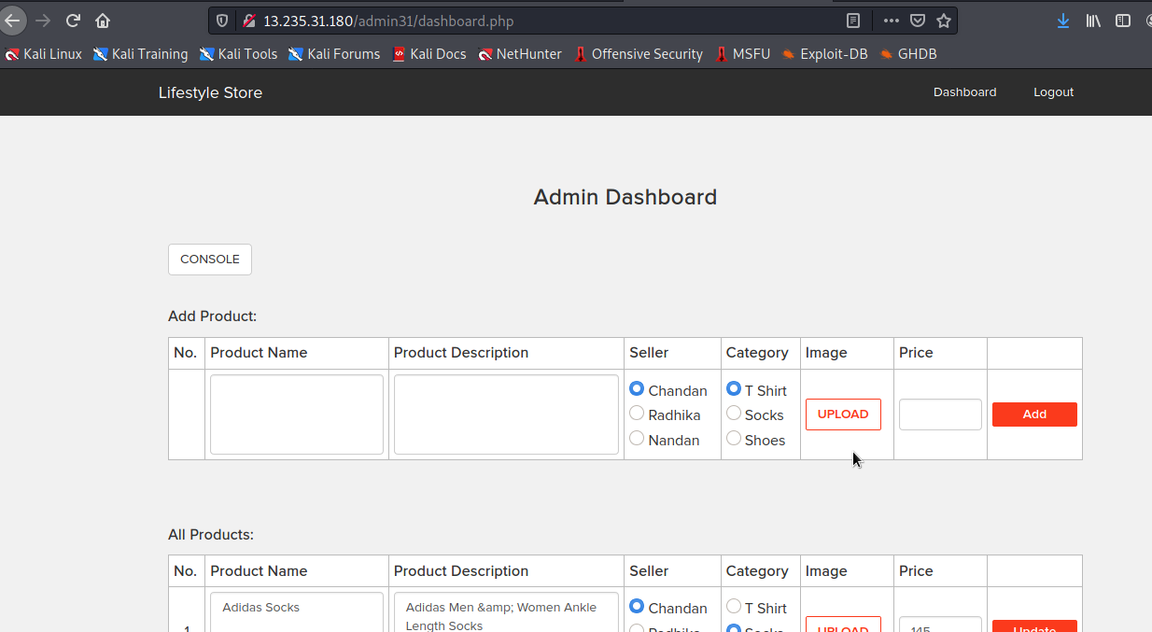
IDOR
proof of concept(PoC)

Slide 41
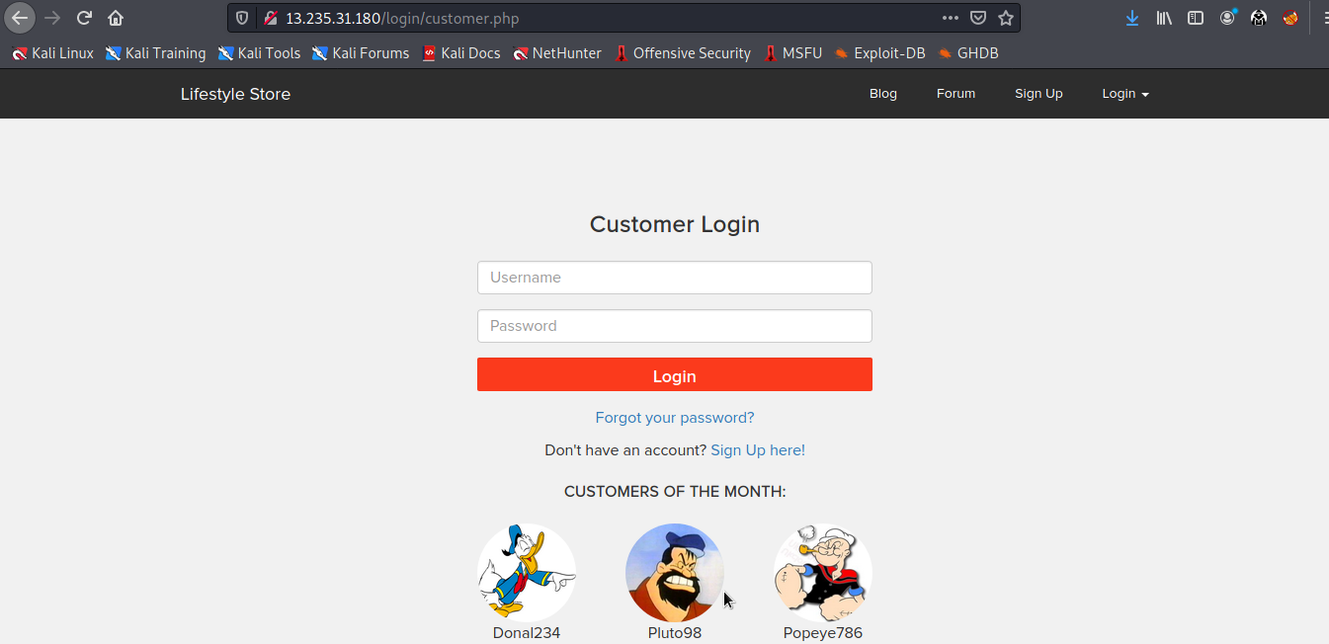
Observation
Navigate to http://13.235.31.180/login/customer.php.
Copy any of the CUSTOMERS OF THE MONTH’s username.

Slide 42
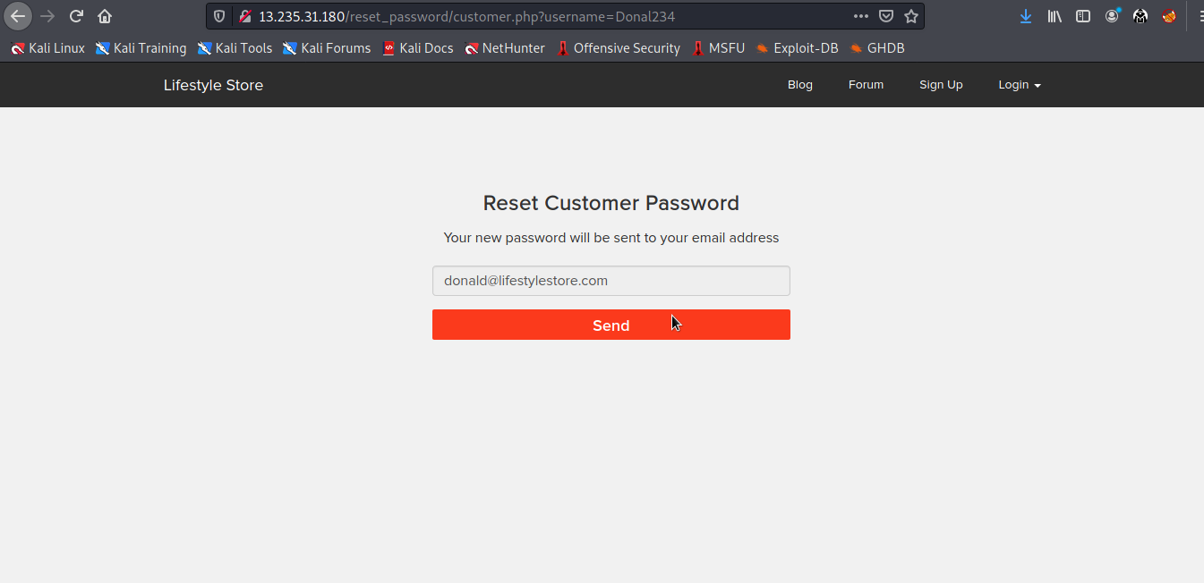
Observation
Navigate to http://13.235.31.180/reset_password/customer.php .
Paste the copied username and click on Reset Password button. You will be redirected to the following page . Hit send.

Slide 43
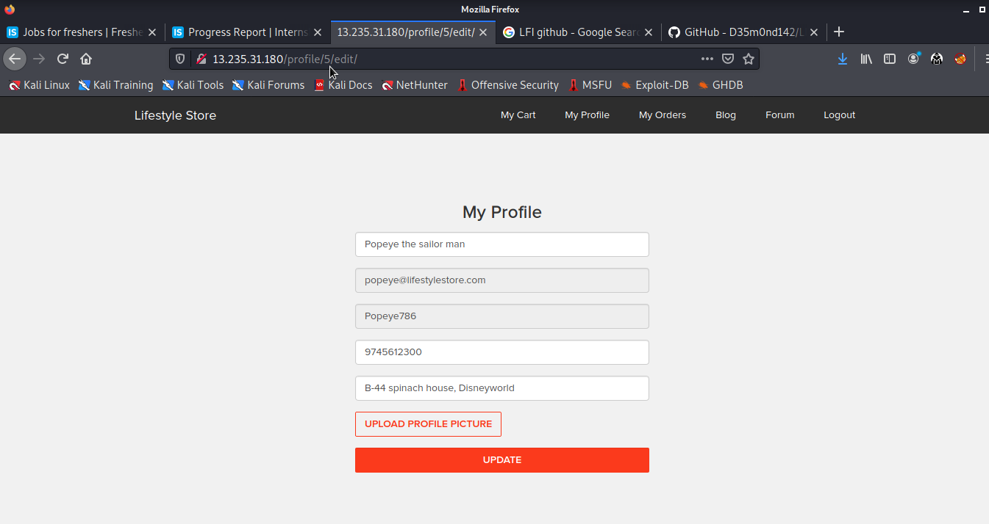
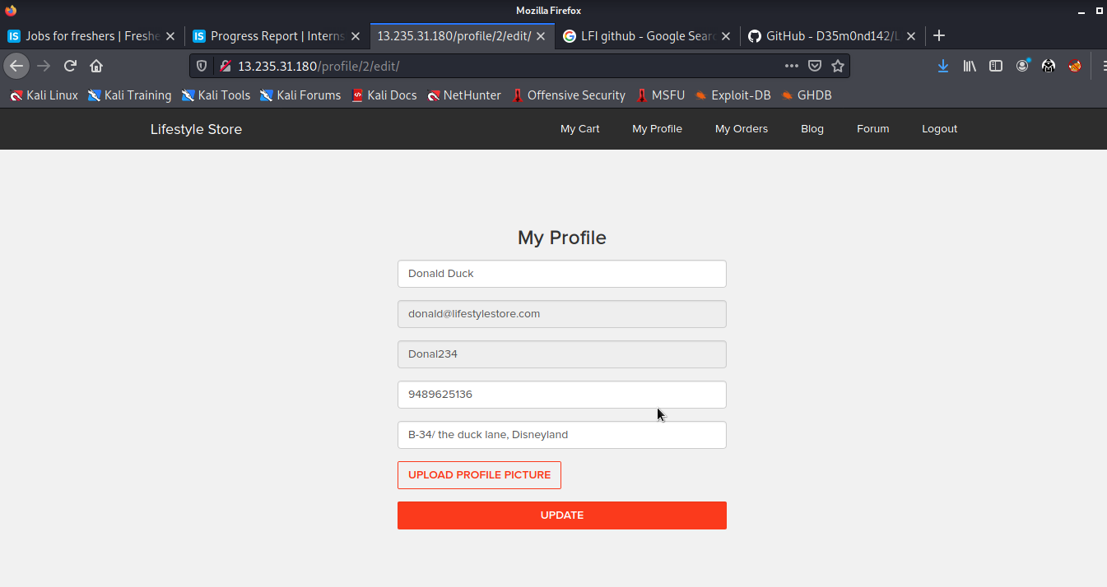
Proof of concept(PoC)
Attacker can change the details and password of the customer easily and can place orders on
user’s behalf.

Slide 44
Recommandations
1.Implement an Anti-CSRF Token.
2.Do not show the customers of the month on the login page.
3.Use the SameSite Flag in Cookies.
4.Check the source of request made.
5.Take some extra keys or tokens from the user before processing an important request.
6.Use 2 factor confirmations like otp , etc. for critical requests.
References
https://www.netsparker.com/blog/web-security/csrf-cross-site-request-forgery/
https://digitalguardian.com/blog/how-secure-personally-identifiable-information-against-loss-or-compromise

Slide 45
6.Command execution
Command Execution Vulnerability (Critical) | Below mentioned URLs is vulnerable to Command Execution. Affected URL : http://13.235.31.180/admin31/console.php Shell can be uploaded at files tab to access the server details at http://13.235.31.180/wondercms/ Affected Parameters : Command (POST parameter)

Slide 46
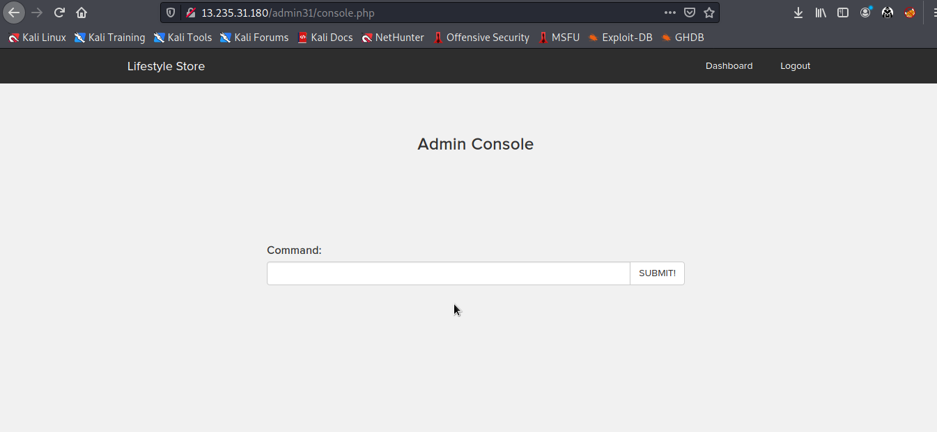
Observations
Navigate to http://13.235.31.180/admin31/console.php after logging in as the admin and you will see the following page.

Slide 47
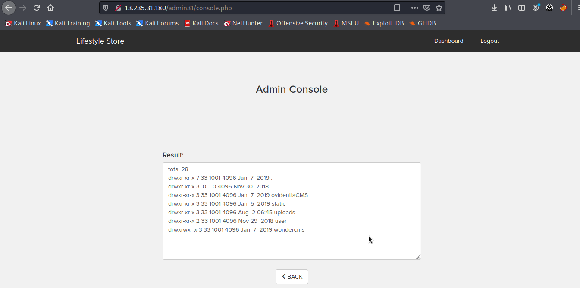
Proof of concept(PoC)

Slide 48
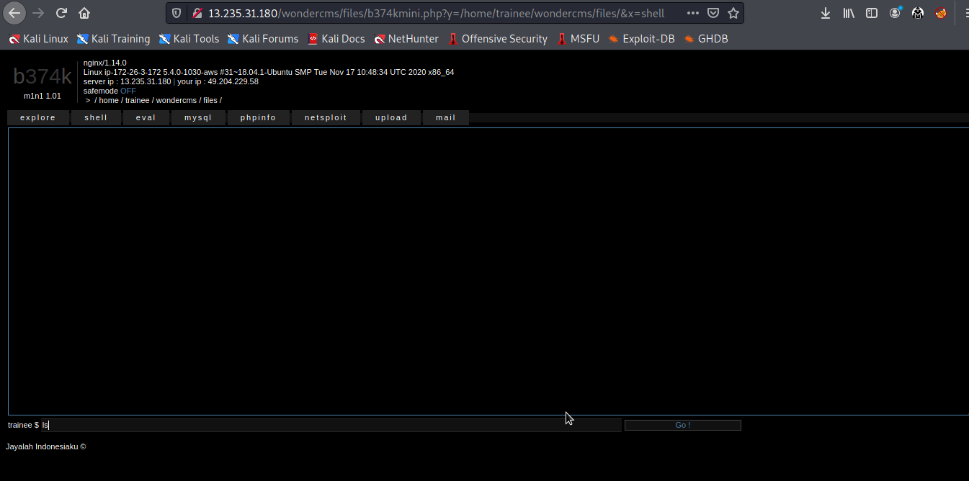
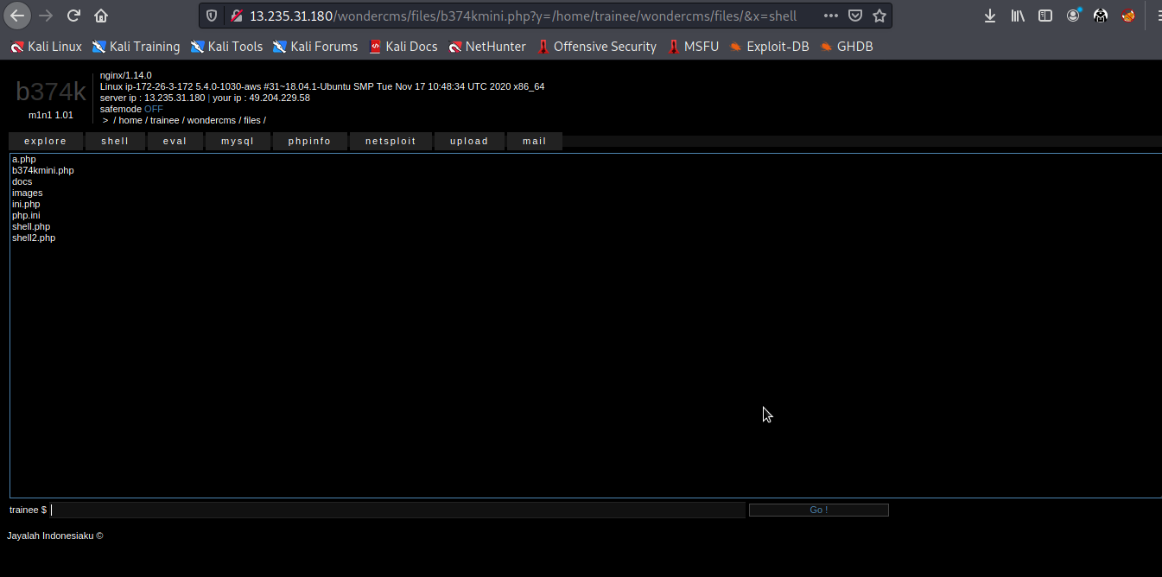
cmd=ls
result

Slide 49
Business impacts-High
1.If the attacker enters into the admin account and finally to the console url ,the he can put in any malicious code to extract or even edit data ,as he the has the admin privileges.
2.Other than entering malicious code , the attacker can even get the details of the websites and its components like its version and hence find vulnerabilities to exploit them
3.If successfully exploited, impact could cover loss of confidentiality, loss of integrity, loss of availability, and/or loss of accountability.
Recommandation
1.There should be filters so that malicious code cannot be injected in
2.Input validation can be done.
3.Output validation can be done.
4.Cononicalization can also be done.
References
1.https://www.owasp.org/index.php/Command_Injection
2.https://www.owasp.org/index.php/Code_Injection

Slide 50
6.Force Browsing
6. Forced Browsing(Critical)
Below mention URL is vulnerable to Forced Browsing attack. Affected URL : http://13.235.31.180/admin31/dashboard.php

Slide 51
Observation
Enter the username : admin and password : admin123 into the admin panel to login in admin account and copy the url of admin panel.
In the seller login page we login into the seller panel as a username : chandan and password : chandan123.

Slide 52
Proof of concept(PoC)
After copy the url of admin panel is paste into the url of seller panel and admin panel is logged out but admin panel is opened in seller’s panel.(For a proof please play the video)

Slide 53
Business Impact
Using this vulnerability, seller can login into the admin panel after logout into the admin. Seller can paste the login url of admin panel in the seller’s panel and he/she will be login in admin panel.
Attacker can change the price of the product and this cause financial loss.
Recommendation
After logout into the account can’t access to login by login url
Using proper access control and authorization policies, access is only given to users commensurate with their privileges
Creating an allow list (or whitelist) involves allowing explicit access to a set of URLs that are considered to be a part of the application to exercise its functionality as intended. Any request not in this URL space is denied by default.

Slide 54
Reference
https://owasp.org/www-community/attacks/Forced_browsing
http://www.imperva.com/application_defense_center/glossary/forceful_browsing.html
https://campus.barracuda.com/product/webapplicationfirewall/doc/42049348/forced-browsing-attack/

Slide 55
8.Cross-site scripting
Cross Site Scripting (Severe) | Below mentioned parameters are vulnerable to reflected XSS Affected URL : http://13.235.31.180/search/search.php?q= Affected Parameters : POST button under Customer Review (POST parameters) Payload: “><script>alert(1)</script> Affected URL : http://13.235.31.180/profile/17/edit/ Affected Parameters : Address (POST parameters) Payload: <script>alert(“Greetings citizens of the world”)</script>

Slide 56
Cross Site Scripting (Severe) | Below mentioned parameters are vulnerable to reflected XSS Affected URL : http://13.235.31.180/products/details.php?p_id=5 Affected Parameters : POST button under Customer Review (POST parameters) Payload: <script>alert(“welcome to my world”)</script> Affected URL : http://13.235.31.180/wondercms/#settingsModel Affected Parameters : Address (POST parameters) Payload: <a>Secured website</a><script>alert(“You’ve been hacked by us”)</script>

Slide 57
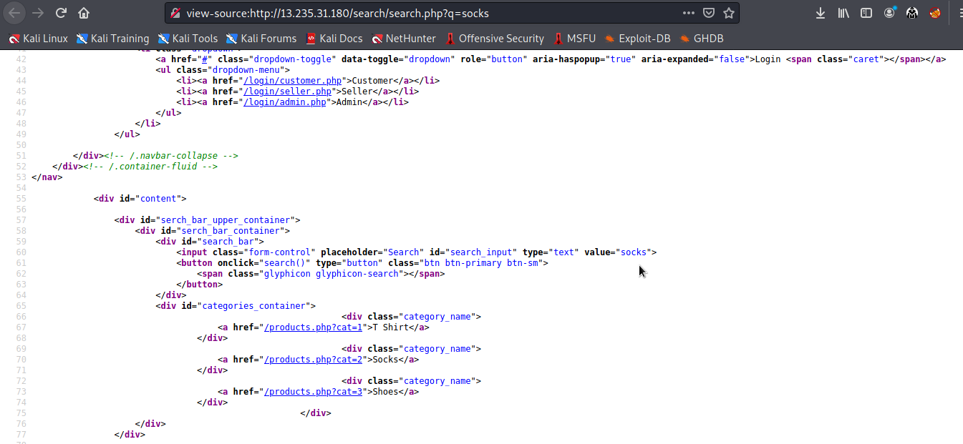
Observations
Go to this page nd look at the source code http://13.235.31.180/search/search.php?q=
looking at the input parameter value=” “> it is not filtered correctly so by passing the payload we can get the payload as we required

Slide 58
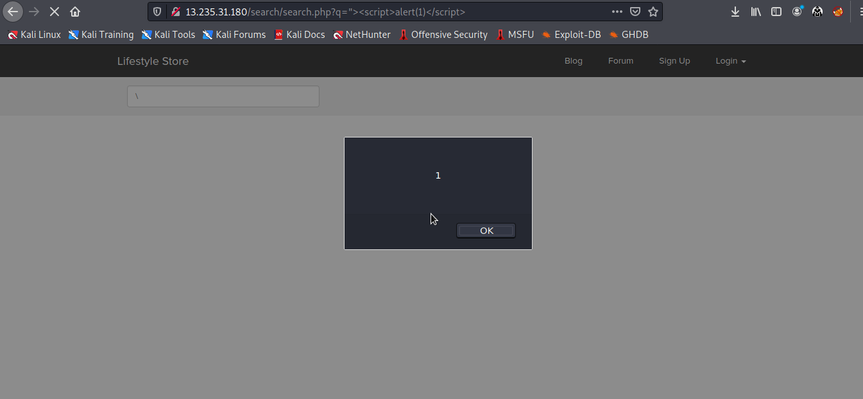
Observation

Slide 59
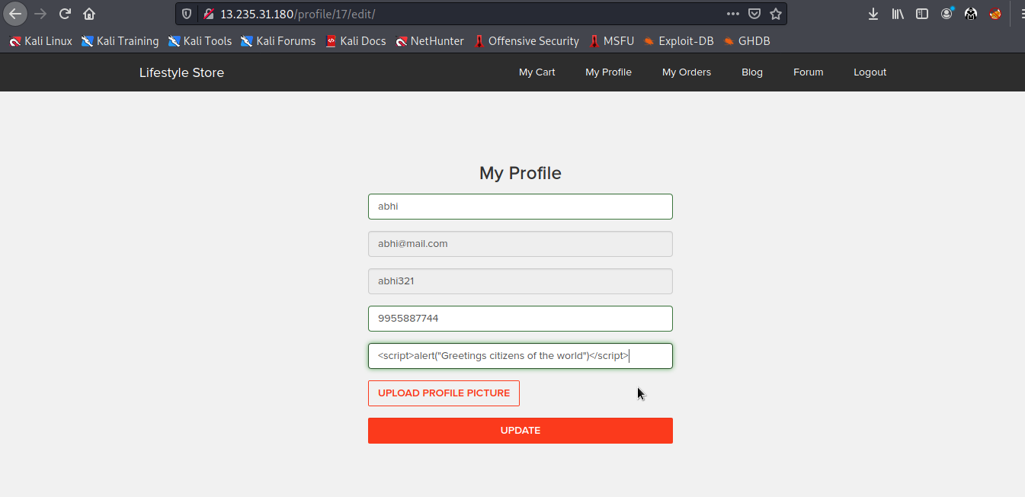
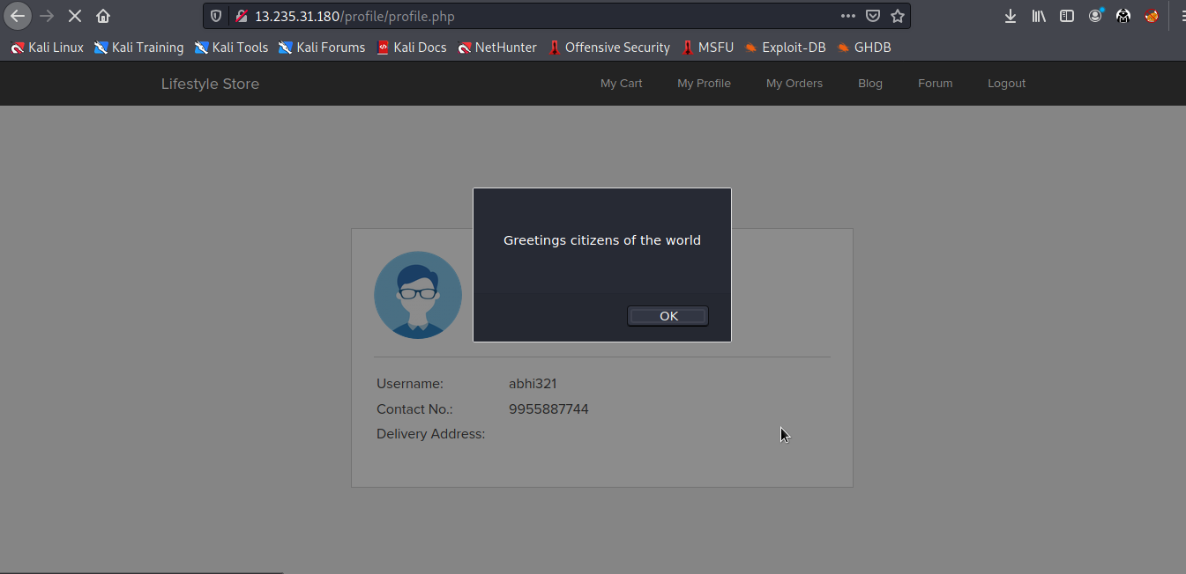
Go to profile page and edit the address tab using the xss payload
in it
Hence the payload has been executed

Slide 60
Recommandation
• Sanitise all user input and block characters you do not want
• Convert special HTML characters like ‘ “ < > into HTML entities &quot; %22 &lt; &gt; before
printing them on the website.
• Apply Client Side Filters to prevent client side filters bypass.
Business impact-High
As attacker can inject arbitrary HTML CSS and JS via the URL, attacker can put any content
on the page like phishing pages, install malware on victim’s device and even host explicit
content that could compromise the reputation of the organisation
All attacker needs to do is send the link with the payload to the victim and victim would
see hacker controlled content on the website. As the user trusts the website, he/she will
trust the content.
References
https://www.owasp.org/index.php/Cross-site_Scripting_(XSS)
https://en.wikipedia.org/wiki/Cross-site_scripting
https://www.w3schools.com/html/html_entities.asp

Slide 61
9.Crypto configuration flaw
Crypto Configuration Flaw( (Severe) | Crypto Configuration Flaws are found in the modules below. Affected URL : http://13.235.31.180/wondercms (All the webpages ,blogs ,forum)

Slide 62
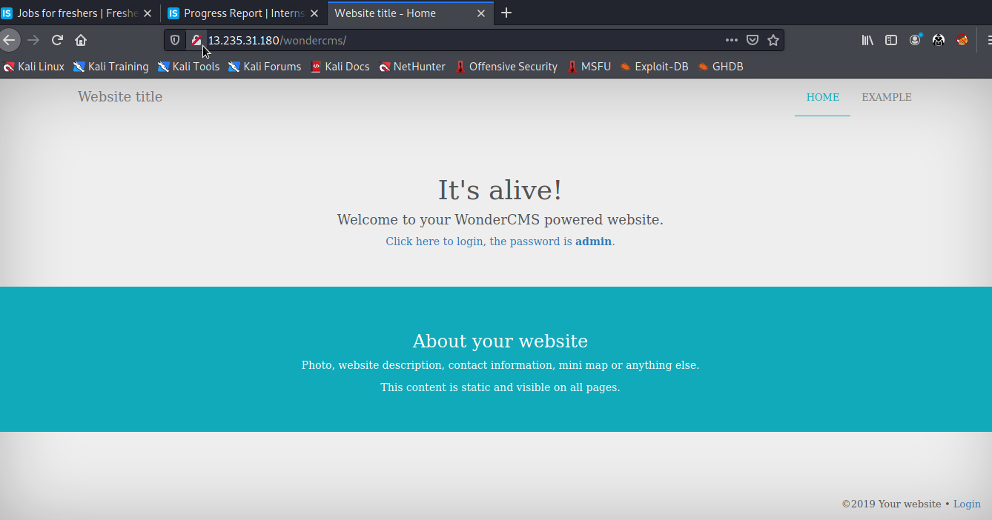
Observation
Clearly ,all the webpages use 'http' and not 'https' which is far less secure and not encrypted

Slide 63
Business impact-High
Security is almost halved in http providing easy man-in-the-middle attack and others which makes it easy for
attacker to go through the data transmitted over the internet.
Recommandation
Use https instead of http as the protocol
References
https://www.owasp.org/index.php/Category:Cryptographic_Vulnerability
https://www.w3.org/Protocols/rfc2616/rfc2616-sec15.html

Slide 64
10.Common passwords
Weak Password Flaw (Severe) | Below given urls have weak passwords. Affected URL : http://13.235.31.180/login/seller.php http://13.235.31.180/wondercms/

Slide 65
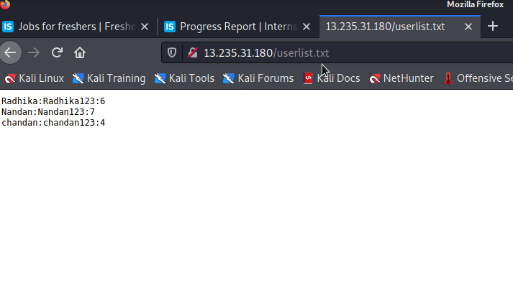
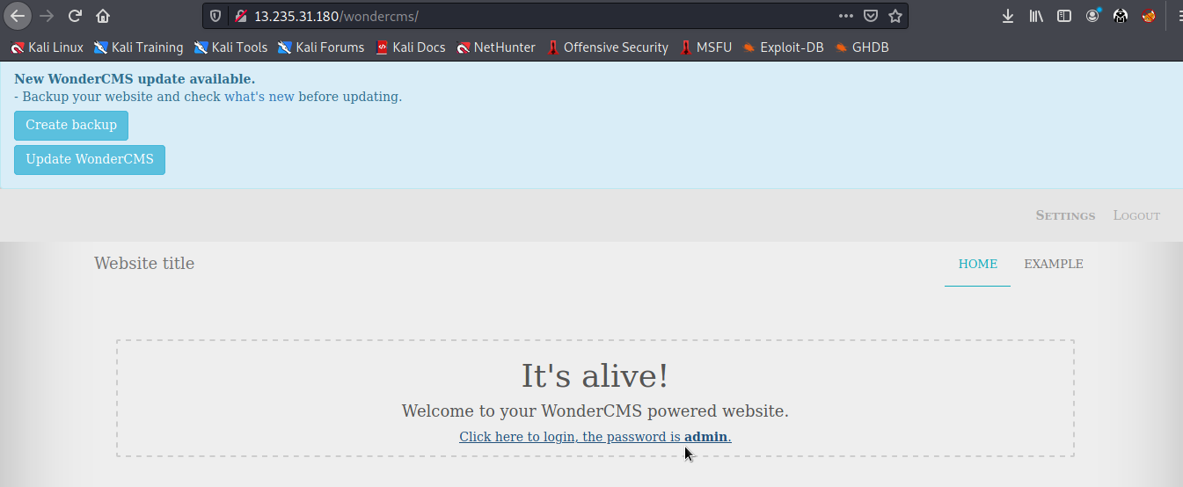
Observation
The passwords of sellers and ,admin of blog ,is very common and easily predictable

Slide 66
Business impact-High
Easy, default and common passwords make it easy for attackers to gain access to their accounts illegal use of
them and can harm the website to any extent after getting logged into privileged accounts
Recommandations
•There should be password strength check at every creation of an account.
•There must be a minimum of 8 characters long password with a mixture of numbers ,alphanumerics ,special characters ,etc.
•There should be no repetition of password ,neither on change nor reset.
•The password should not be stored on the web, rather should be hashed and stored.
References
https://www.acunetix.com/blog/articles/weak-password-vulnerability-common-think/
https://www.owasp.org/index.php/Testing_for_Weak_password_policy_(OTG-AUTHN-007)

Slide 67
11.Rate limiting flaw
11. Rate Limiting Flaw(Severe)
Below URL is vulnerable to Rate Limiting Flaw. Affected URL : http://13.235.31.180/login/seller.php Affected Parameter : Username,Password (POST parameter)

Slide 68
11. Rate Limiting Flaw(Severe)
Affected URL : http://13.235.31.180/login/customer.php Affected parameter : Username,Password (POST parameter)
Affected URL : http://13.235.31.180/login/admin.php Affected parameter : Username,Password (POST parameter)
Affected URL : http://13.235.31.180/forum/index.php?u=/user/login Affected parameter : Username,Password (POST parameter)

Slide 69
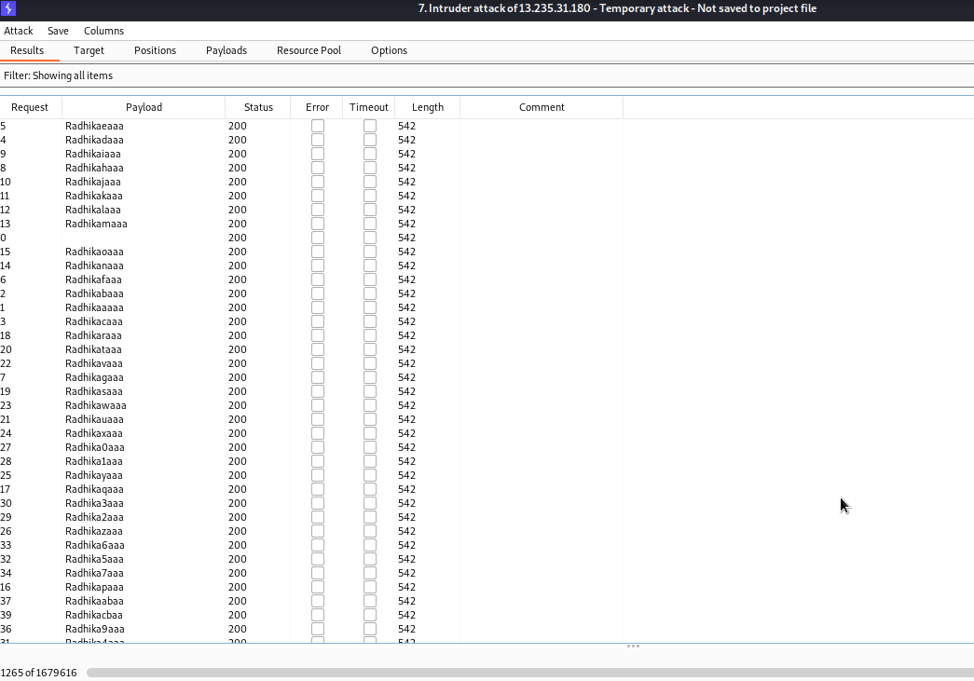
observation
When put the credentials in the login fields we intercept this request in burpsuit, then send the request in intruder to change the value of username and password hence we get correct password and username

Slide 70
Business Impact
Using this vulnerability, attacker can get the password using dictionary bruteforcing and easily get username and password of any login account.
Attacker can create lots of malicious account in this site by rate limiting flaws.
Recommendation
When the password are incorrect morethan 5 times blocked that resource for some time.
Number of attempts can be limited.
The password length must be large so bruteforcing can be not possible.
Captcha should be used to protect from bruteforce.

Slide 71
Reference
https://medium.com/bugbountywriteup/bypassing-rate-limit-abusing-misconfiguration-rules-dcd38e4e1028
https://www.keycdn.com/support/rate-limiting
https://ussignal.com/blog/protect-against-cyber-attacks-with-rate-limiting

Slide 72
12.Open redirection
 | The Lang module is vulnerable to open redirection.
 | Affected URL :
 | http://13.235.31.180/?includelang=lang/en.php
 | http://13.235.31.180/?includelang=lang/fr.php http;//13.235.31.180/products/details.php?p_id=5
 | Affected Parameters :
Open Redirection | lang (GET parameters)
(Severe)
 | Payload used:
 | http://13.235.31.180/?includelang=https://google.com/?lang/en.php
 | http://13.235.31.180/redirect.php?url=https://internshala.com

Slide 73
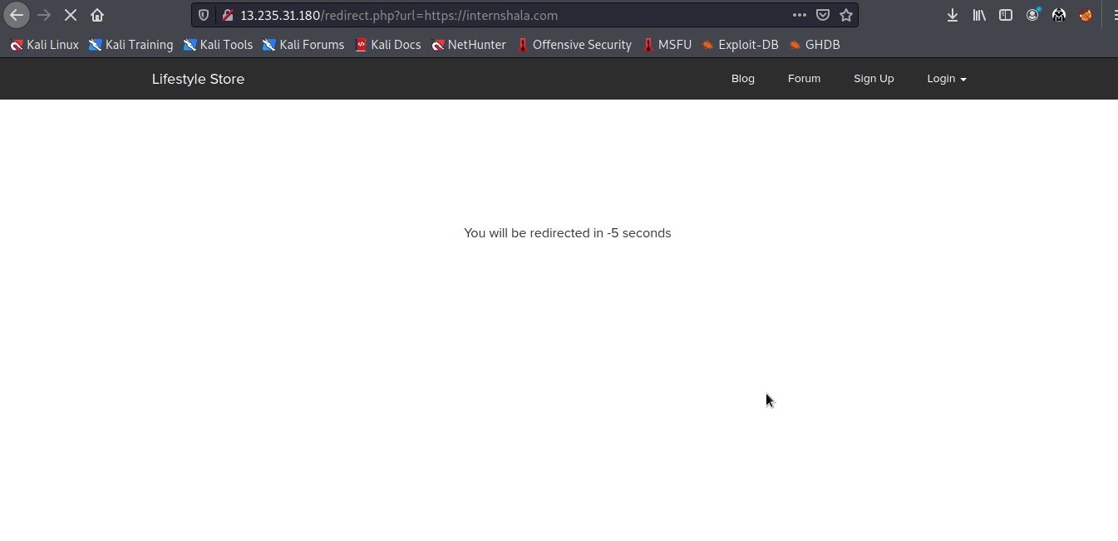
Observation
Url of product is in GET based parameter so we can change the url and redirect to other site.
Payload : http://13.235.31.180/redirect.php?url=https://www.internshala.com

Slide 74
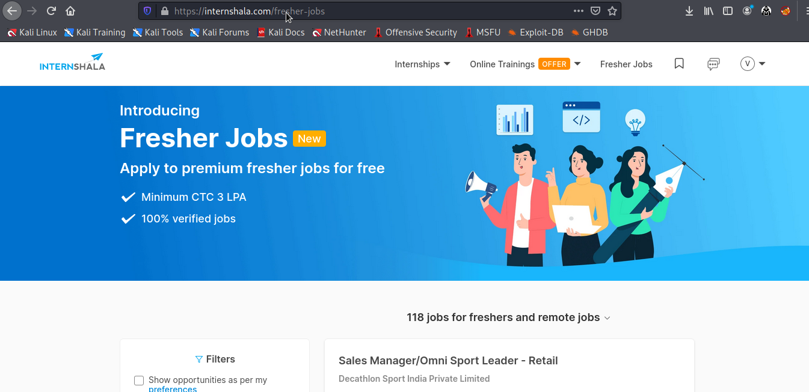
Proof of Concept(PoC)
We put http://13.235.31.180/redirect.php?url=https://www.internshala.com payload in the url and we redirect to new site.

Slide 75
Business Impact
If the attacker changes the url to some malicious website looking similar to the given website, he can take the credentials and even credit card details on checkout from the user trust.
Recommendation
Remove the redirection function from the application, and replace links to it with direct links to the relevant target URLs.
Maintain a server-side list of all URLs that are permitted for redirection. Instead of passing the target URL as a parameter to the redirector, pass an index into this list.

Slide 76
Reference
https://owasp.org/www-project-web-security-testing-guide/latest/4-Web_Application_Security_Testing/11-Client_Side_Testing/04-Testing_for_Client_Side_URL_Redirect
https://owasp.org/search/?searchString=open+redirection

Slide 77
13.Cross-Site Request Forgery
Cross Site Request Forgery(Severe)
Below mention URL is vulnerable to Cross Site Request Forgery attack. Affected URL : http://13.232.66.58/profile/18/edit Affected Parameter : Name, Phone, Address (POST parameter)

Slide 78
Cross Site Request Forgery(Severe)
Affected URL : http://13.232.66.58/profile/change_password.php Affected parameter : Update (POST parameter)
Affected URL : http://13.232.66.58/cart/cart.php Affected parameter : Confirm order (POST parameter)

Slide 79
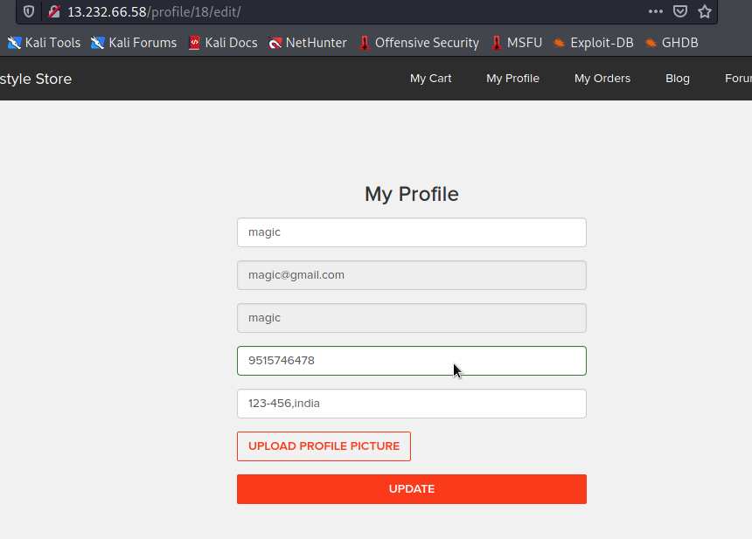
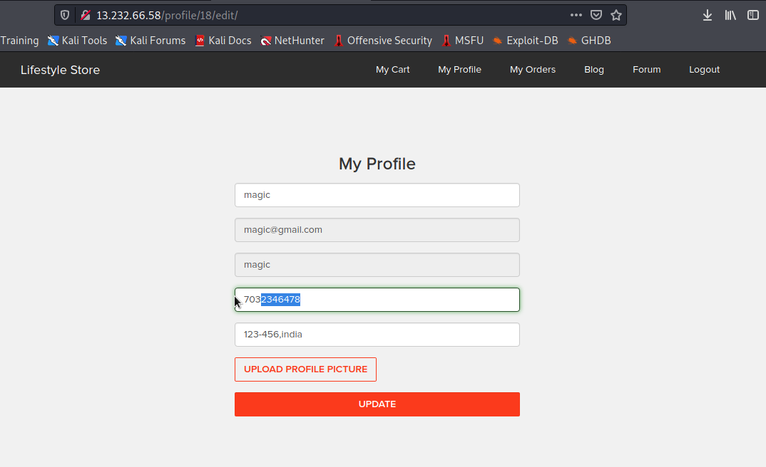
Observation
We navigate http://13.232.66.58/profile/18/edit after login into account.
Before
After

Slide 80
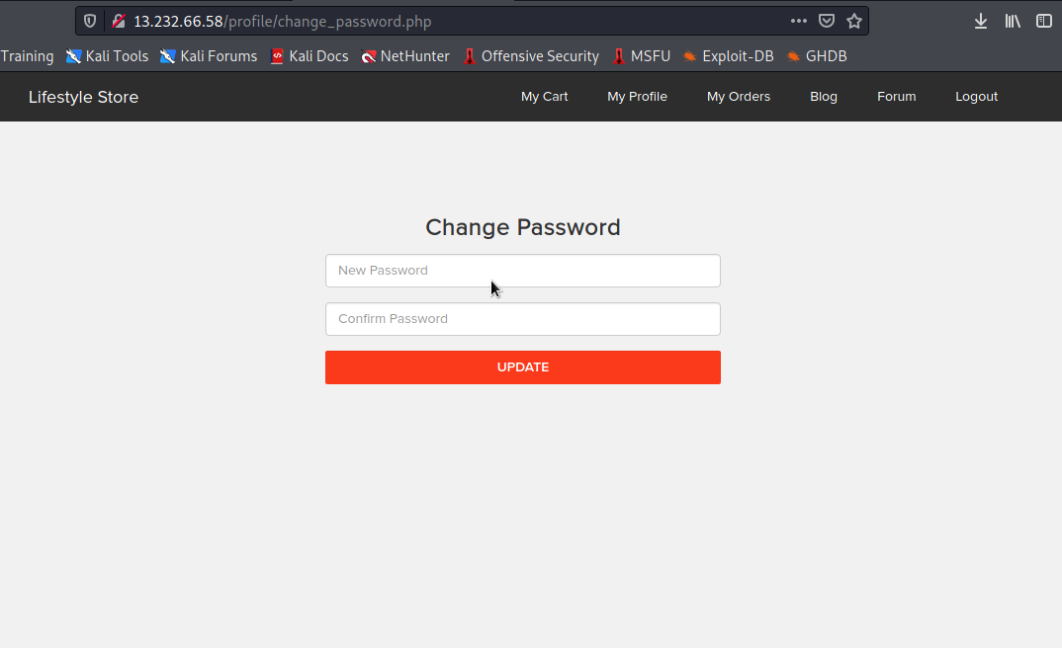
Observation
We navigate http://13.232.66.58/profile/change_password.php after login into account.

Slide 81
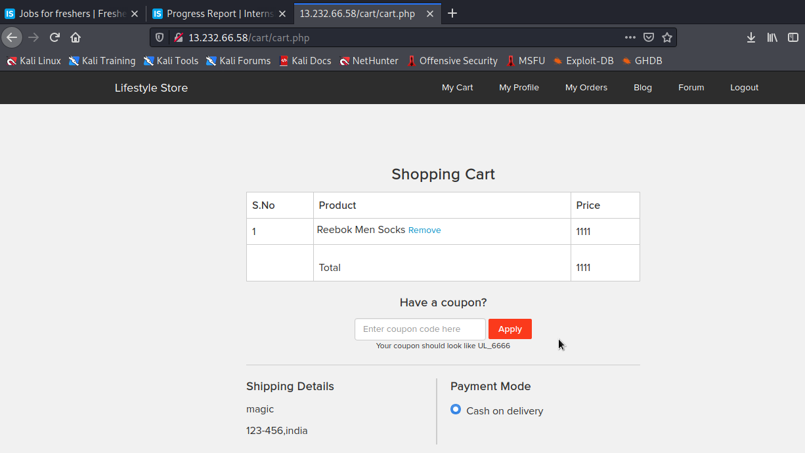
Observation
We select the product and add to cart for buy that product.

Slide 82
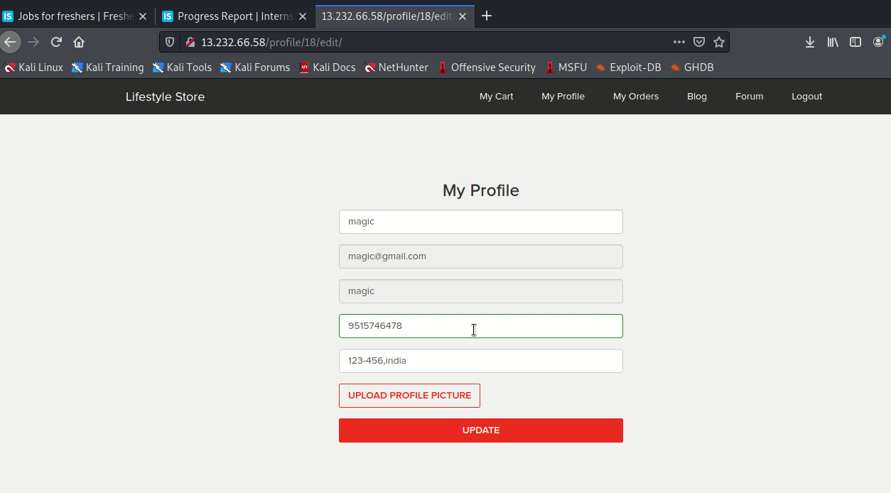
Proof of concept(PoC)

Slide 83
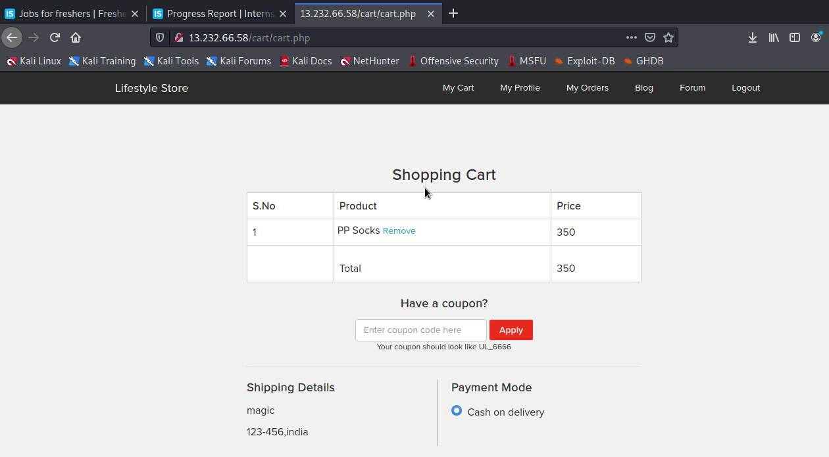
You can find the other PoC in the files mentioned as follows

Slide 84
Business Impact
Using this vulnerability, attacker can able order many item which item user would cancel later when the sender will send it to him(as its cash on delivery),so unnecessary load of workers can increase incredibly.
Attacker can change the username, password, address, etc. with the help of this vulnerability.
Recommendation
Check the referer to before carrying out action.
Ask the user his password (temporary like OTP or permanent like login password) at every critical action like while deleting account, making a transaction, changing the password etc.
Implement the concept of CSRF tokens which attach a unique hidden password to every user in every <form>. Read the documentation related to the programming language and framework being used by your website

Slide 85
Reference
https://owasp.org/www-community/attacks/csrf
https://wiki.owasp.org/index.php/Testing_for_CSRF_(OTG-SESS-005)
https://en.wikipedia.org/wiki/Cross-site_request_forgery

Slide 86
14.Unauthorised availability of Details
Unauthorised Access to Customer Details (Severe) | The Show My Orders module is vulnerable from an Insecure Direct Object Reference (IDOR) that allows attacker see to anyones user details. Affected URL : http://13.235.31.180/orders/orders.php?customer=2 Affected Parameters : customer (GET parameters) Payload used: http://13.235.31.180/orders/orders.php?customer=5

Slide 87
Unauthorised Access to Customer Details (Severe) | Similarly other vulnerable urls are given below. Affected URL : http://13.235.31.180/orders/orders.php?customer=2 http://13.235.31.180/orders/orders.php?customer=5 http://13.235.31.180/orders/orders.php?customer=8 http://13.235.31.180/orders/orders.php?customer=13 http://13.235.31.180/orders/orders.php?customer=14

Slide 88
Unauthorised Access to Customer Details (Severe) | Affected URL : http://13.235.31.180/profile/2/edit/ Affected Parameters : user_id (GET parameters) Payload used: http://13.235.31.180/profile/3/edit/

Slide 89
Observation
Login using any customer of the month’s details. Then navigate to the below link.
http://13.235.31.180/profile/2/edit/
Now remove 2 and insert 5 in the url like shown in the given screenshot and you will see the details of another user .

Slide 90
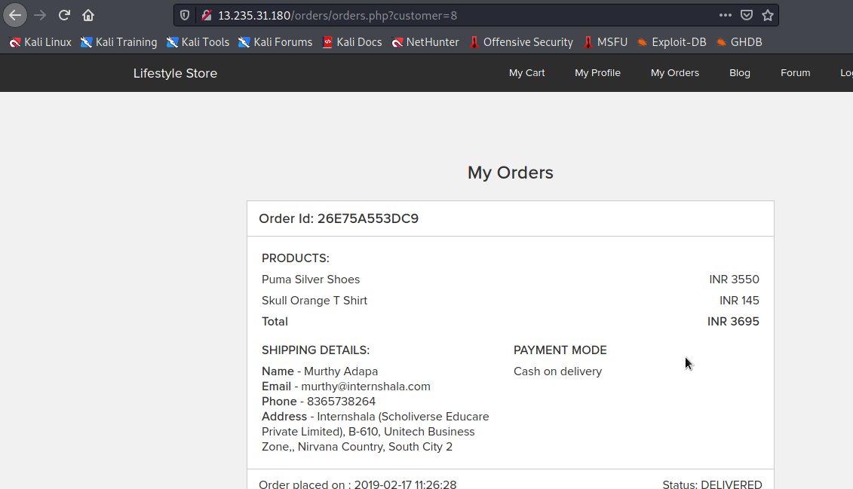
Proof of concept(PoC)
Below is the screenshot of the bill details of another user accessed from attacked user’s account.

Slide 91
Business impact-Extremely high
A malicious hacker can read bill information and account details of any user just by knowing the customer id and User ID. This discloses critical billing information of users including:
Mobile Number
Bill Number
Billing Period
Bill Amount and Breakdown
Phone no. and email address
Address
This can be used by malicious hackers to carry out targeted phishing attacks on the users and the information can also be sold to competitors/blackmarket.
More over, as there is no ratelimiting checks, attacker can bruteforce the user_id for all possible values and get bill information of each and every user of the organization resulting is a massive information leakage.

Slide 92
Recommandations
Take the following precautions:
Implement proper authentication and authorisation checks to make sure that the user has permission to the data he/she is requesting
Use proper rate limiting checks on the number of request comes from a single user in a small amount of time
Make sure each user can only see his/her data only.
References
https://www.owasp.org/index.php/Insecure_Configuration_Management https://www.owasp.org/index.php/Top_10_2013-A4-Insecure_Direct_Object_References

Slide 93
15.Information disclosure due to default pages
Directory Listing (Moderate) | Below mentioned urls disclose server information. Affected URL : http://13.235.31.180/phpinfo.php http://13.235.31.180/robots.txt http://13.235.31.180/composer.lock http://13.235.31.180/composer.json http://13.235.31.180/userlist.txt

Slide 94
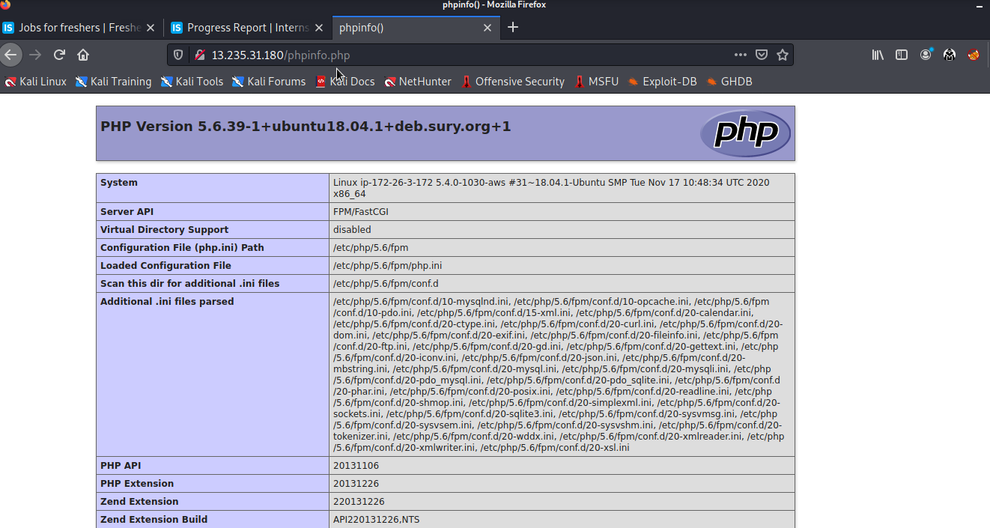
Observation
Navigate to http://13.235.31.180/phpinfo.php and you will see the below

Slide 95
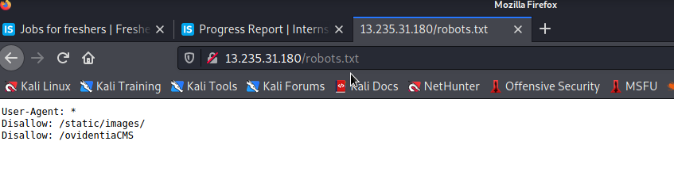
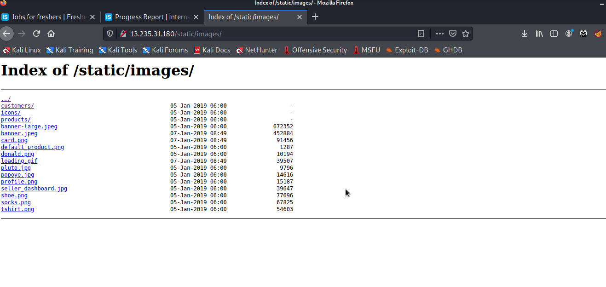
Observation
Navigate to http://13.235.31.180/robots.txt and you see the paths and can go to them

Slide 96
Proof of concept(PoC)

Slide 97
Proof of concept(PoC)

Slide 98
Business impact-Moderate
Although this vulnerability does not have a direct impact to users or the server, though it can aid the attacker with information about the server and the users.
Information Disclosure due to default pages are not exploitable in most cases, but are considered as web application security issues because they allows malicious hackers to gather relevant information which can be used later in the attack lifecycle, in order to achieve more than they could if they didn’t get access to such information.

Slide 99
Recommandations
Take the following precautions:
Disable all default pages and folders including server-status and server-info.
Multiple security checks enabled on important directories.
References
https://www.netsparker.com/blog/web-security/information-disclosure-issues-attacks/
https://www.netsparker.com/web-vulnerability-scanner/vulnerabilities/information-disclosure-phpinfo/

Slide 100
16.Unnecessary details about sellers
 | Below mentioned URL gives the unnecessary details about the seller (PII).
Unnecessary Details about Sellers (Moderate) | Affected URL : http://13.235.31.180/products/details.php?p_id=2 http://13.235.31.180/products/details.php?p_id=5 http://13.235.31.180/products/details.php?p_id=17

Slide 101
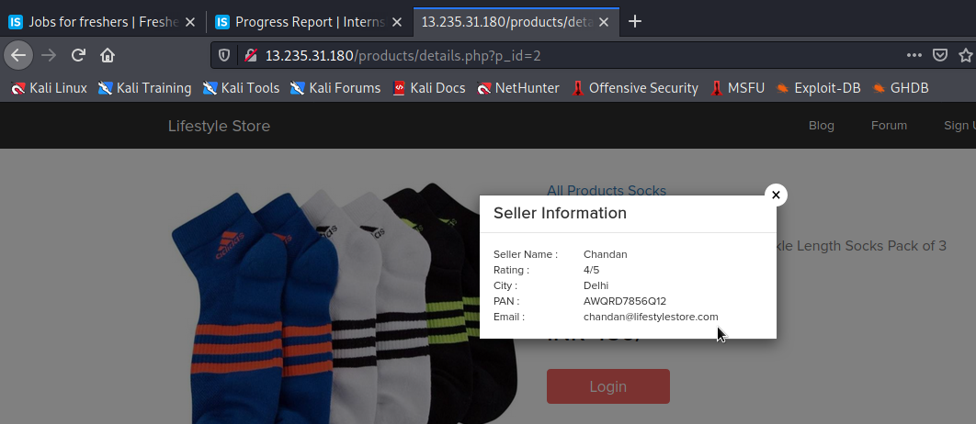
Observation
When we click on the Seller Info option ,we get the details of the seller ,even those which are not required like the pan card number ,etc.

Slide 102
Business Impact-Moderate
There is no direct business impact in this case ,but this amount of information can definitely lead to social engineering attacks on the seller and can indirectly harm the business.
The information could be sold to rival business companies .
Sellers can be unnecessarily be pranked.
Recommandation
Only name and email is sufficient as far as the query or help is concerned
References
https://digitalguardian.com/blog/how-secure-personally-identifiable-information-against-loss-or-compromise

Slide 103
17.Components with known vulnerabilities
Components with known Vulnerabilities (Critical) | Server used is nginx/1.14.0 appears to be outdated (current is at least 1.19.0) i.e it is known to have exploitable vulnerabilities. WonderCMS

Slide 104
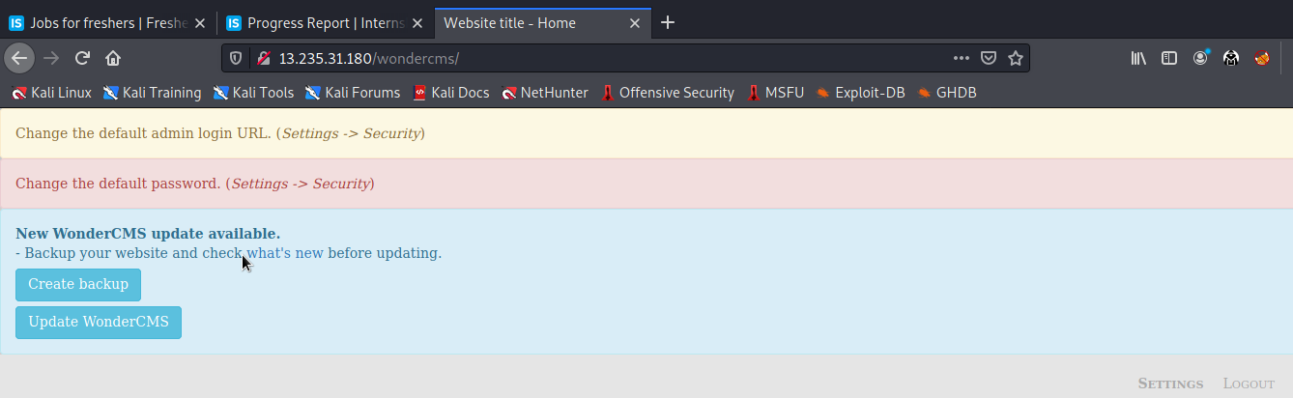
Observation
The PHP version installed is not the latest one and has multiple vulnerabilities that can be exploited.Also, wondercms is also outdated and highly vulnerable.

Slide 105
Business impact-High
Exploits of every vulnerability detected is regularly made public and hence outdated software can very easily be taken advantage of.If the attacker comes to know about this vulnerability ,he may directly use the exploit to take down the entire system, which is a big risk.
Recommandations
Upgrade to the latest version of Affected Software/theme/plugin/OS which means latest version.
If upgrade is not possible for the time being, isolate the server from any other critical data and servers.
References
https://usn.ubuntu.com/4099-1/ http://securitywarrior9.blogspot.com/2018/01/vulnerability-in-wonder-cms-leading-to.html

Slide 106
18.Default error display
 | Below mentioned urls have default error displaying on fuzzing:
 | Affected URL : http://13.235.31.180/?includelang=lang/en.php
 | Payload en’.php (GET Parameter)
Default Error Display
(Low) | Affected URL: http://13.235.31.180/products.php/cat=3
 | Parameter: cat (GET Parameter)
 | Payload: cat='

Slide 107

Observation
The default error with the path is displayed as:

Slide 108

Proof of Concept(PoC)
When we give cat=3' in the search option of the home page ,we get the error as:

Slide 109
Business impact-Moderate
Although this vulnerability does not have a direct impact to users or the server, though it can help the attacker in mapping the server architecture and plan further attacks on the server
Recommandation
Do not display the default error messages because it not tells about the server but also sometimes about the location.So, whenever there is an error ,send it to the same page or throw some manually written error.
Reference
https://www.owasp.org/index.php/Improper_Error_Handling

Slide 110
19.Improper server side & client side filters
 | Below mentioned urls have improper server side filter
 | Affected URL : http://13.233.124.212/profile/16/edit/
Improper Server Side and | Affected parameter: Contact Number (POST Parameter)
client side Filter (Low) | Payload used: 9000000000/90000000001234
 | Other Affected URL :
 | http://13.233.124.212/forum/index.php?u=/user/register

Slide 111


Observation
After logging in as customer, when we try to edit the phone number to some invalid one , the error is as shown.
Also if phone no. with correct length is entered but actually doesn’t exist, it is validated.

Slide 112


Proof of concept(PoC)

Slide 113


Hence the phone number has been changed as per our wish

Slide 114



Slide 115

Proof of concept(PoC)

Slide 116
Business impact-Low
The data provided by the user ,if incorrect, is not a very big issue but still must be checked for proper validatory information
Recommandations
Implement all critical checks on server side code only.
Client-side checks must be treated as decoratives only.
All business logic must be implemented and checked on the server code. This includes user input, the flow of applications and even the URL/Modules a user is supposed to access or not.
Reference
http://projects.webappsec.org/w/page/13246933/Improper%20Input%20Handling
https://www.owasp.org/index.php/Unvalidated_Input

Slide 117
THANK YOU
For any further clarifications/patch assistance, please contact:+917075441778

